Slide 1
Vision + Language Modelling
Nandhagopalan Elangovan, AIAC

Slide 2

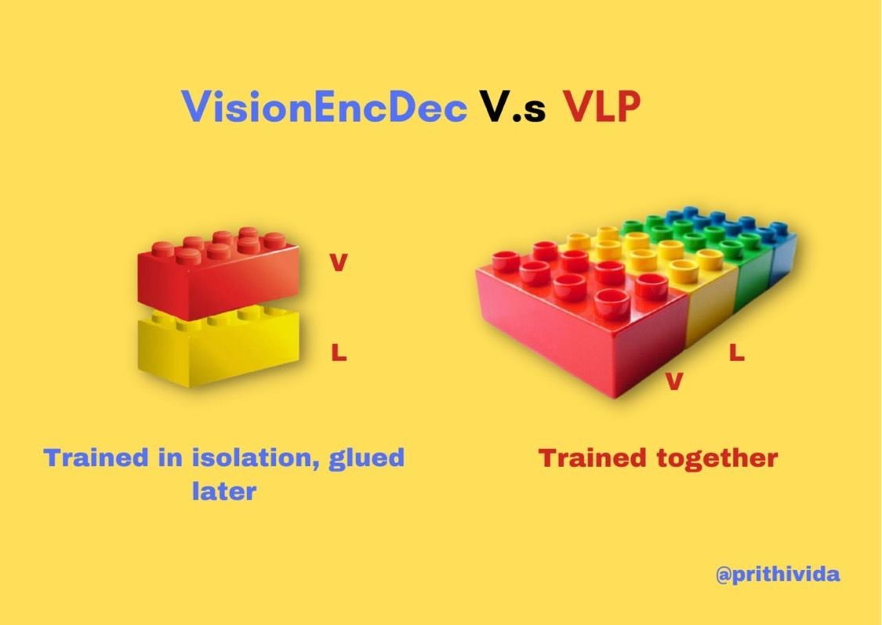

Vision + Language Paradigm
V + L
Vision
Language
Vision enc and Lang dec (that are trained in isolation) like Lego blocks using cross attention for multimodal tasks
Unified VLP models are typically pertained on a large amount of image-text pairs with “creative“ self-supervised objectives & loss functions
“Better image-text alignment”
“Poor image-text alignment”, “huge data appetite” & “longer training time”.
Notes:
Slow down the video,

Slide 3
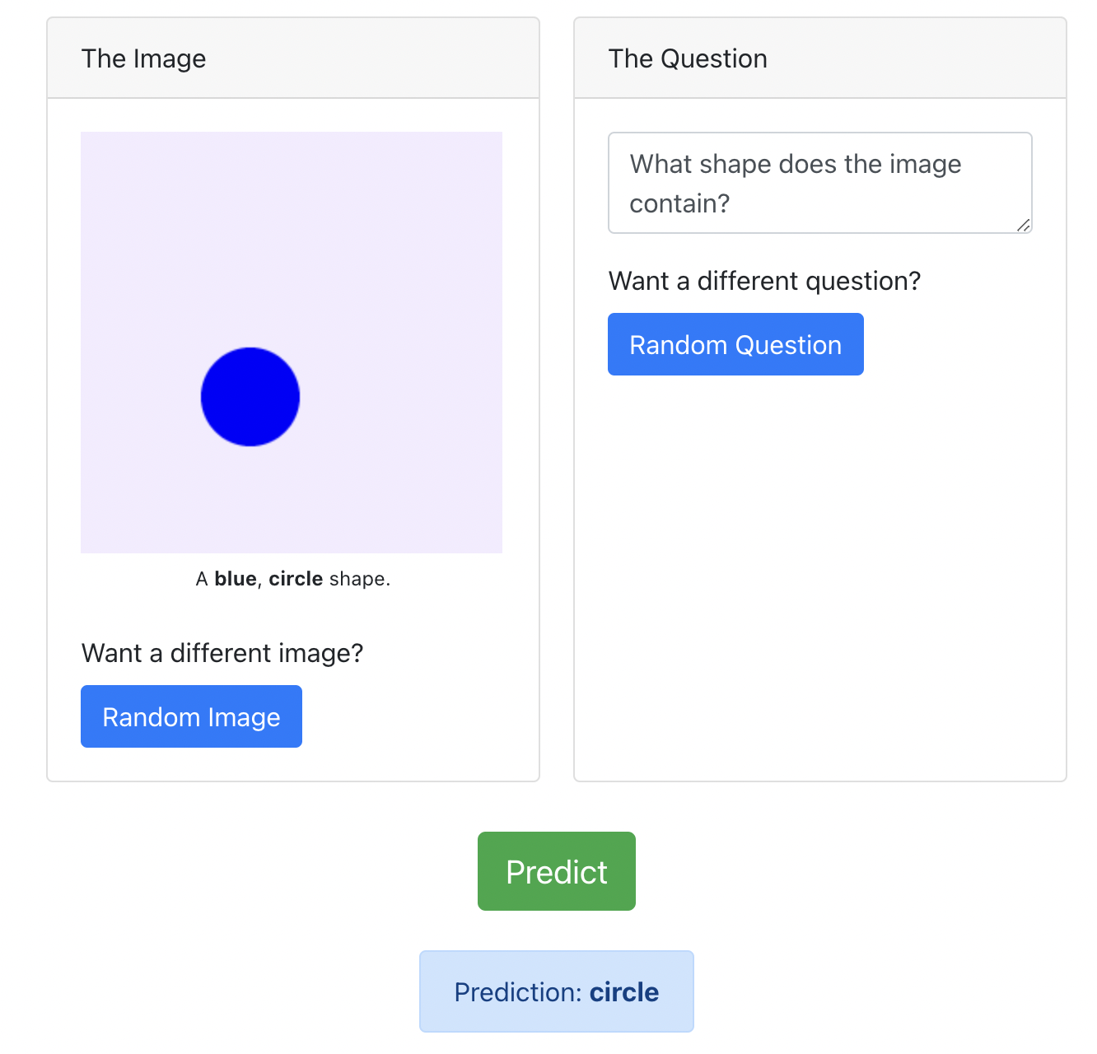
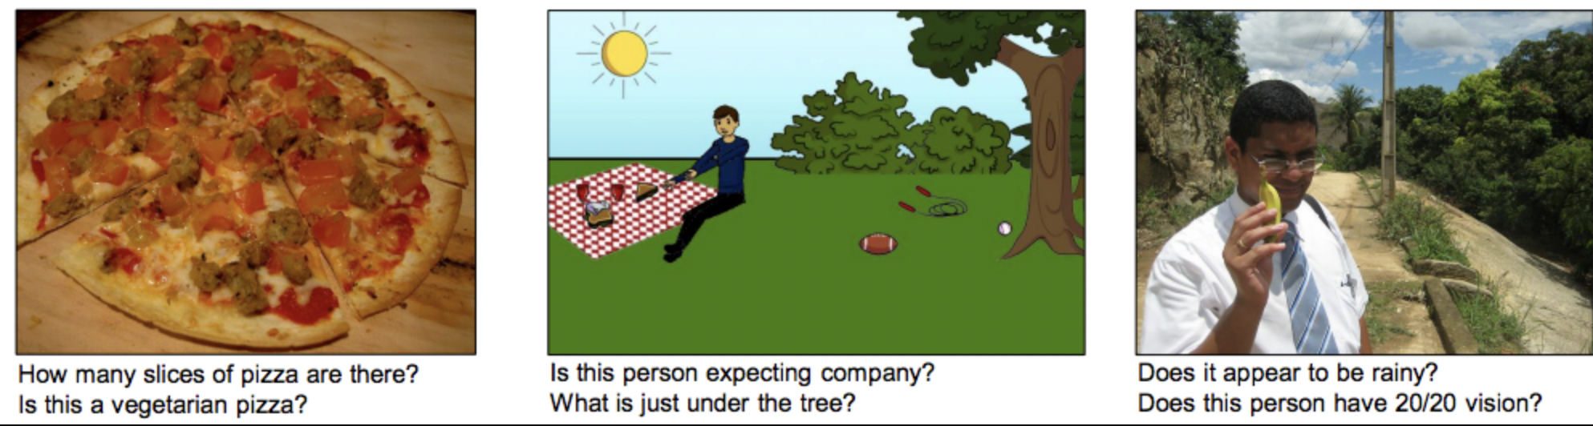
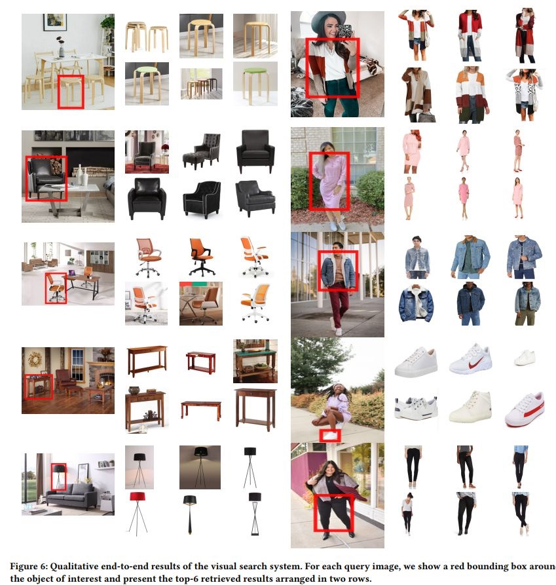
Applications
VQA, Visual Question Answering
CBIR, Content Based Image Retrieval
Notes:
Slow down the video,

Slide 4
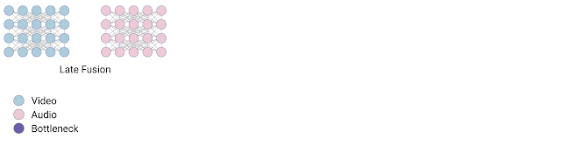
Fusion Techniques
Notes:
Slow down the video,

Slide 5
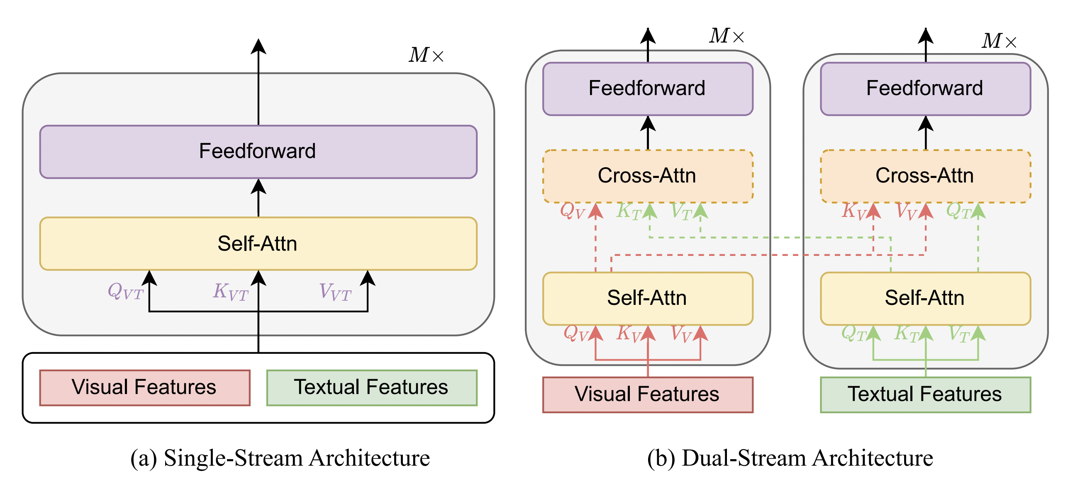
Single stream vs double stream architecture
Visual Language Pretraining
Notes:
Slow down the video,

Slide 6
Pretraining Objectives - VLP
 | Unimodal objectives
Masked Language Modelling
Prefix Language Modelling | Unimodal objectives
Masked Vision Modelling
Vision- Language Modelling | Alignment objectives
Vision – Language Contrastive Learning | Alignment objectives
Image – Text Matching
Vision – Language Matching
Notes:
Slow down the video,

Slide 7
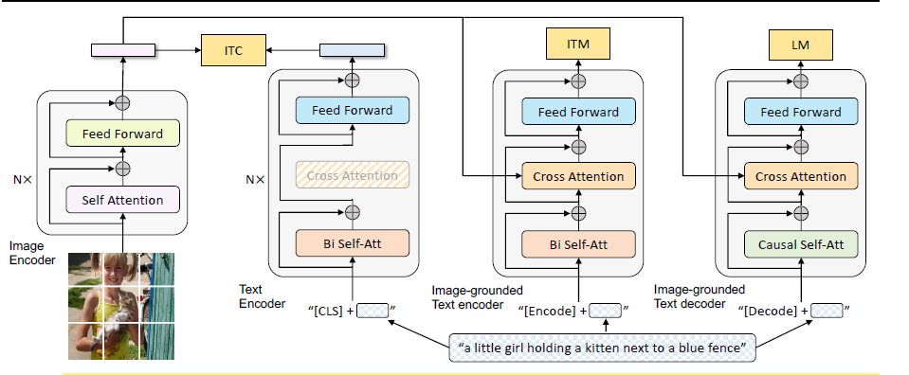
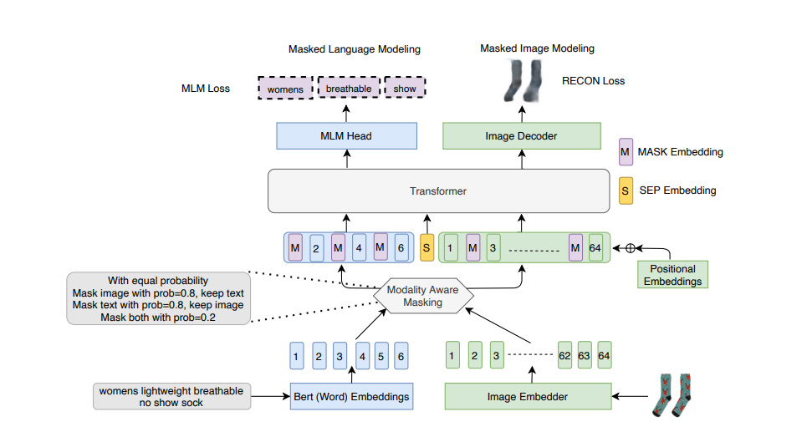
Personal Favorites
BLIP
MLIM
Notes:
Slow down the video,

Slide 8
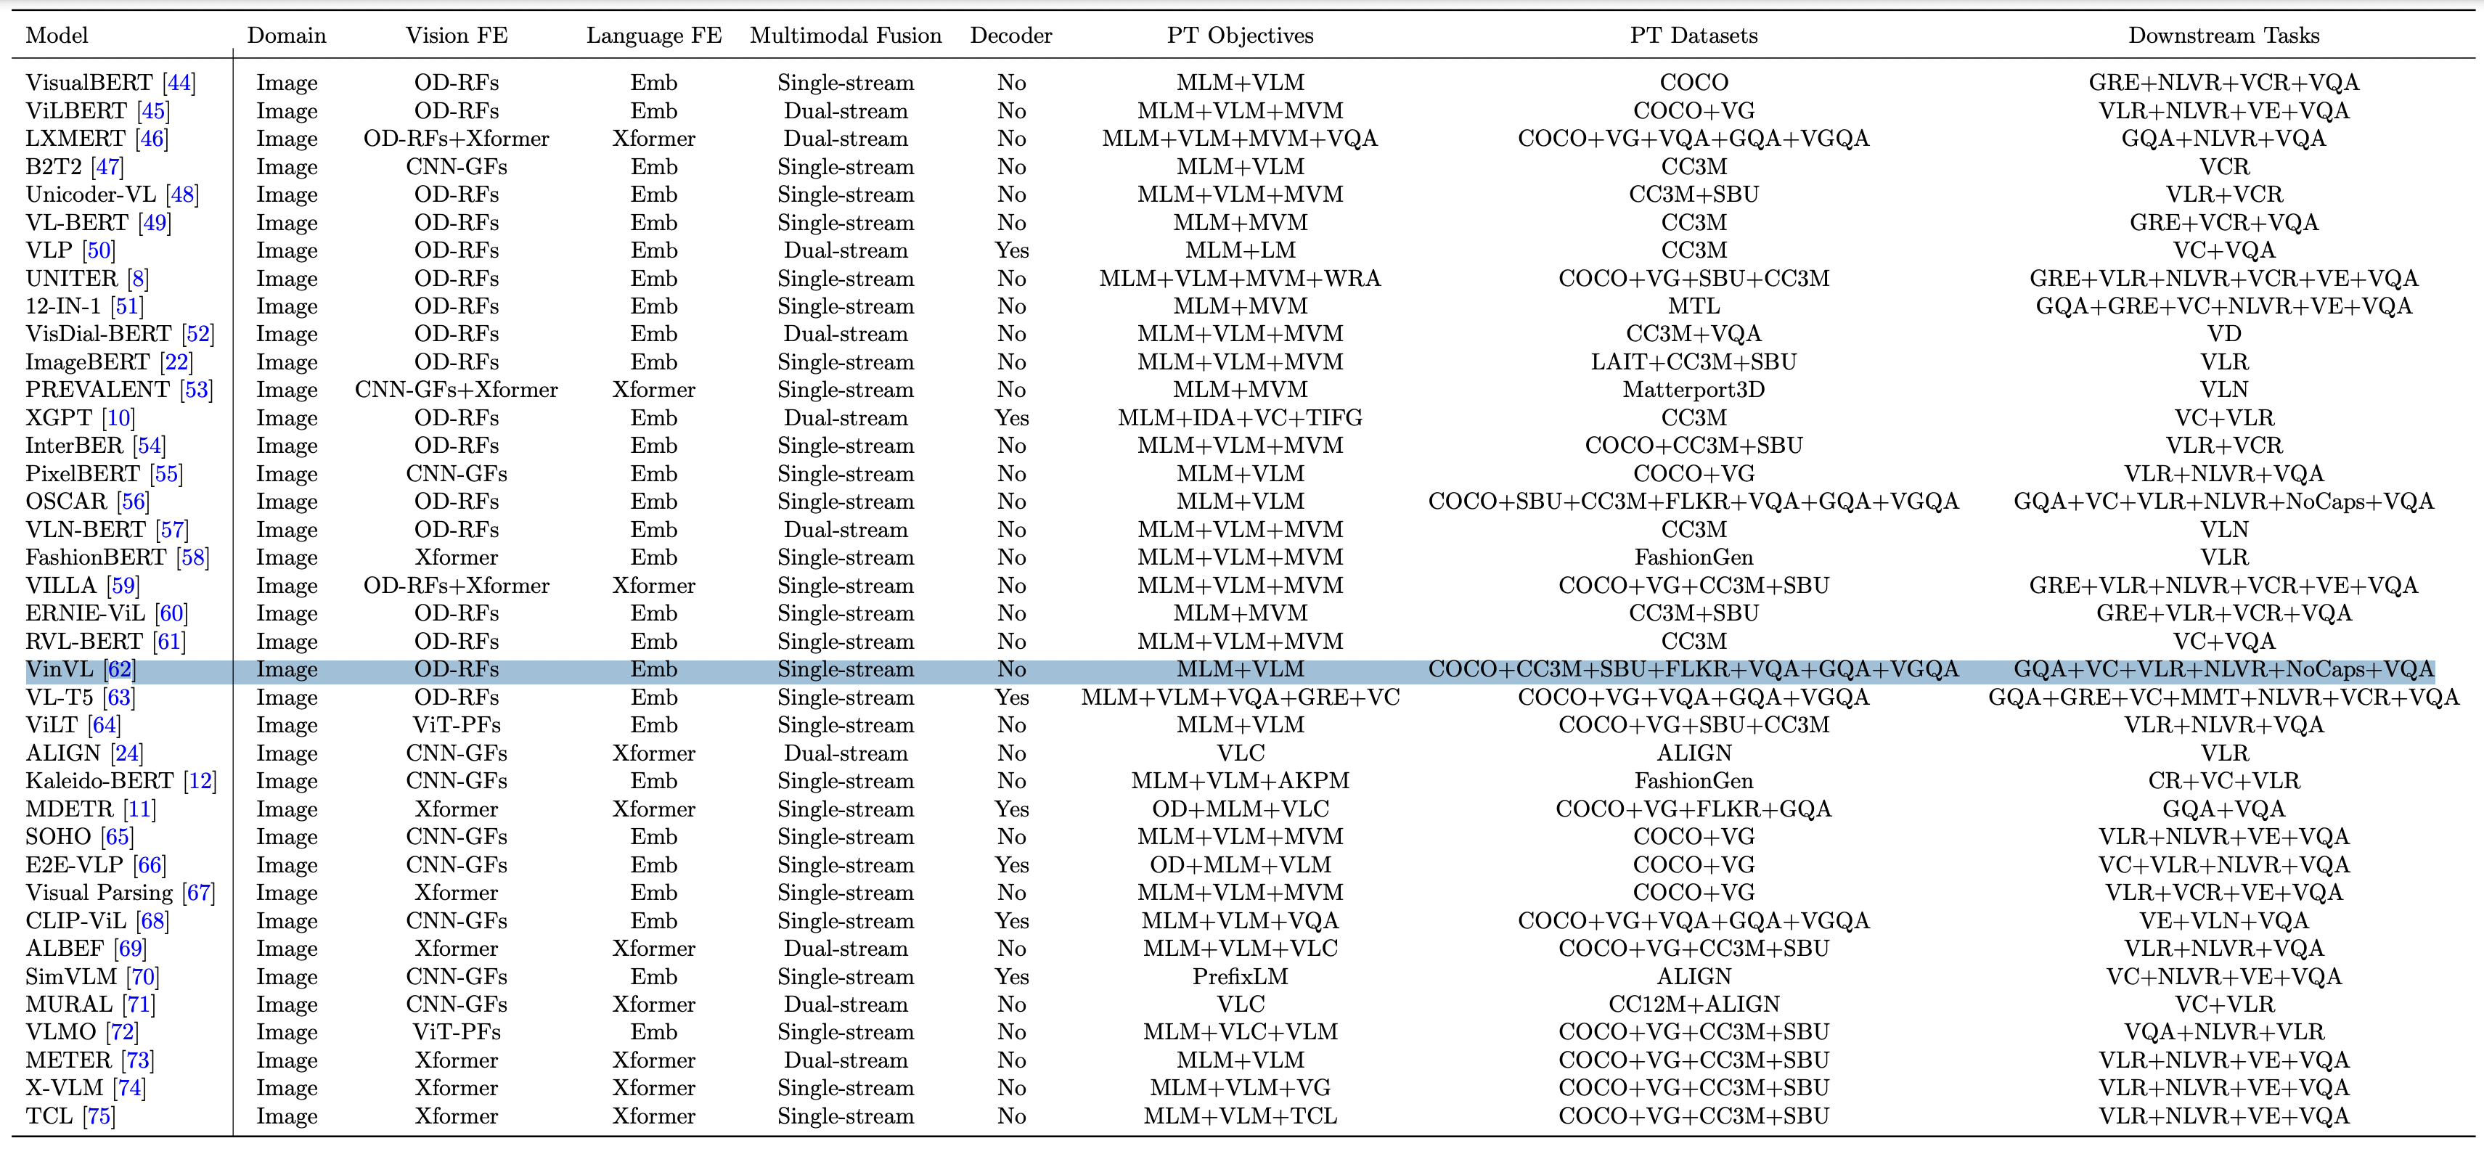
List of VLP models
Notes:
Slow down the video,

Slide 9
Demo & usecase
Notes:
Slow down the video,

Slide 10
References
https://huggingface.co/docs/transformers/model_doc/vision-encoder-decoder
https://www.donkeystereotype.com/vision-language-modelling
https://arxiv.org/abs/2202.09061
Notes:
Slow down the video,

Slide 11
Thank you

